Slide 1


Guided Pathways: Completion, Equity, and Economic Mobility

Slide 2
Outcomes for Retreat
Reinforce the case for pathways reforms and the central emphasis on achieving equity
Identify and address challenges involved with pathways implementation
Understand the relationship between economic mobility and guided pathways
Reflect on RCC’s current status on pathways design and implementation
Identify clear next, mid-range, and longer-term steps for moving forward with pathways

Slide 3
RIVERSIDE COMMUNITY COLLEGE DISTRICT: GUIDED PATHWAYS
Riverside Community College District embraces the Guided Pathways model of improving performance-based data, integrating innovation and wrap around, integrated student and academic services, resulting in increased student access, equity and success.
Notes:
From the RCCD brochure on GP

Slide 4
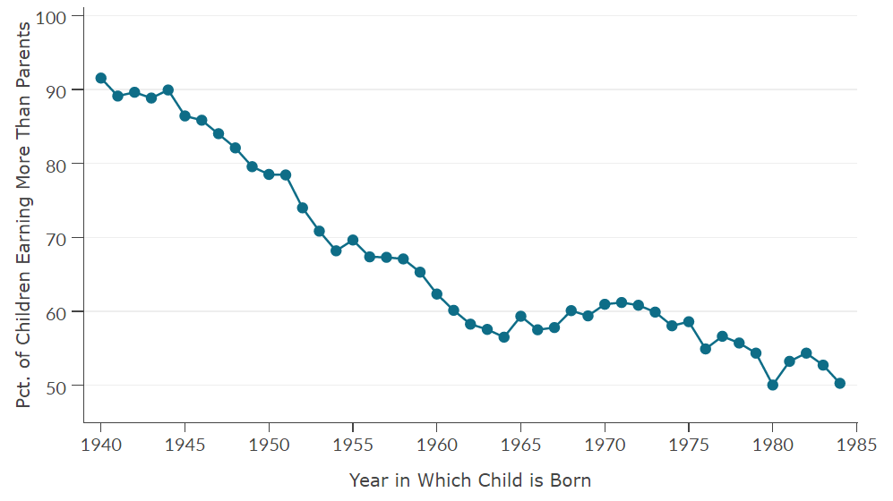
The Fading American Dream
Percent of Children Earning More than their Parents, by Year of Birth
Children's prospects of earning more than their parents have fallen from 90% to 50% over the past half century.

Slide 5
Lifetime Earnings Gains by Degree Type
(compared to HS only)
Source: NELS Data, Marcotte, Bailey, Borkoski, & Kienzl, 2005, p. 164-165, 170-171.

Slide 6
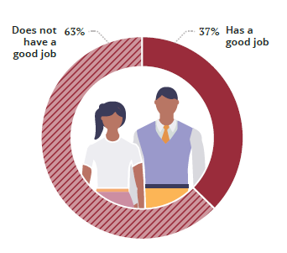
Share of Latino Workers without a Bachelor’s Degree
with a good job
Source: Georgetown University Center on Education and the Workforce analysis of pooled ACS data (2011-15).
Notes:
And for students of color, the need is even greater.

Slide 7
Colleges and Upward Mobility
Upward mobility rates – measured, for instance, by the fraction of students who come from families in the bottom income quintile and reach the top quintile – vary substantially across colleges.

Slide 8
Colleges vary in their effect on Social Mobility
Top Mobility Colleges Require Access + Success
Top 10 Colleges by Mobility Rate (Bottom to Top 20%)
Rank | Name | Mobility Rate | = Access x | Success Rate
1 | Cal State University – LA | 9.9% | 33.1% | 29.9%
2 | Pace University – New York | 8.4% | 15.2% | 55.6%
3 | SUNY – Stony Brook | 8.4% | 16.4% | 51.2%
4 | Technical Career Institutes | 8.0% | 40.3% | 19.8%
5 | University of Texas – Pan American | 7.6% | 38.7% | 19.8%
6 | CUNY System | 7.2% | 28.7% | 25.2%
7 | Glendale Community College | 7.1% | 32.4% | 21.9%
8 | South Texas College | 6.9% | 52.4% | 13.2%
9 | Cal State Polytechnic – Pomona | 6.8% | 14.9% | 45.8%
10 | University of Texas – El Paso | 6.8% | 28.0% | 24.4%
Equality of Opportunity Project (Chetty et al., 2017)

Slide 9
Guided Pathways and the Vision for Success
The Guided Pathways model
Embodies equity
Is not just another initiative
Is a comprehensive approach to combating poverty
Is a means to realize social and economic justice
Starts with careers and works backwards
Increases transfer
Increases living wages
But how, why is Guided Pathways different?
Notes:
Not “another initiative” but a comprehensive approach to combating poverty, a means to realize social and economic justice
Increasing transfer and living wage attainment by considering the outcome of the educational process first and working backward
Requires considering the steps in the process that help students to attain meaningful vocations
Brings together a number of elements – equity and success, for example – in new ways
Requires a serious rethinking of how we do things – and gives RCC an opportunity to help the Inland Empire move forward in combatting poverty

Slide 10
Widespread Reform – Little Progress
A decade of the “Completion Agenda”
Institutional and sector student outcomes have not improved
WHY?

Slide 11
Problem with the Structure of Community Colleges
Reforms too small or narrowly focused
Reforms not scaled
Reforms limited to one segment of student experience
Colleges built to promote enrollment—Self Service or Cafeteria Model

Slide 12

Notes:
This lack of clarity has devastating consequences for many of our students as you’ll see as we move forward.

Slide 13
Cafeteria College
Paths to career goals unclear
Churning
Early transfer
Intake sorts, diverts students
Completion
Excess credits
Students’ progress not monitored
Time to degree
Learning outcomes not defined and assessed across programs
Skill building

Slide 14
Why Does the Guided Pathways Framework Work?
Provides all students with clear course taking patterns
Promotes better enrollment decisions
Prepares students for future success
Integrates comprehensive student support services
Ensures students are learning
Notes:
The Guided Pathways Model creates a highly structured approach to student success that:
Provides all students with a set of clear course-taking patterns that promotes better enrollment decisions and prepares students for future success.
Integrates support services in ways that make it easier for students to get the help they need during every step of their community college experience.

Slide 15
Pathways include more than RCC
Pathways are designed to take students from high school through RCC, to a four year institution or directly to employment, and to careers that offer living wages, and new mechanisms are in place to make these transitions more seamless for students.
Dual enrollment and CCAP Agreements
ADTs, preliminary UC “pathways” for some majors
Increased pressure on CSU and UCs to take more transfer students or risk losing funding
Partnerships are central to pathways work.
Notes:
Institute 3 language

Slide 16
What changes taking place at the state and national level have an impact on RCC’s pathways work?

Slide 17
Current Trends Driving Change in Higher Education
TREND | DESCRIPTION
Changing Student Characteristics and Needs | Students with varied learning styles come from diverse family, educational, and community backgrounds; Students are more mobile, attending multiple institutions
Technological Advances | Today’s students are digital natives and take more online classes
Competition for Students | The number of high school graduates remains static or has declined
Economic and Competitive Forces | Knowledge-based economy calls for education to cultivate knowledge workers; Financial support for colleges has declined as the pressure to reduce college costs has increased
Skepticism About Educational Quality | Waning public confidence in the quality of American postsecondary education
Notes:
Source: Using Evidence of Student Learning to Improve Education by Kuh, et al. (2015)

Slide 18
Designing and Implementing Guided Pathways—the picture from the state
The 2017-18 California State Budget included funding for Guided Pathways across the California Community Colleges. These funds are meant to
Augment existing financial support such as the Student Success and Support Programs (SSSP), Equity, the Basic Skills Initiative, and Strong Workforce.
Help colleges scale effective programs, services and activities to include all students by providing a clear planning framework
This is about changing the STRUCTURE of our colleges, not narrowly focused on piecemeal reforms
Notes:
RCC is already a leader in this area as Guided Pathways are the framework for RCC’s Educational Master Plan and Strategic Plan. In addition, we are among the 20 participating in the CA Guided Pathways project.

Slide 19
GOALS from the State Chancellor’s Office
Goal 1: Increase > 20% annual # of degrees, certificates, or special skill sets
Goal 2: Increase by 35% # of transfer students
Goal 3: Decrease excess units from 87 to 79 or less
Goal 4: Increase % of CTE students employed in field of study from 60% to 69%
Goal 5: Decrease equity gaps by 40% in 5 years and within 10 years eliminate equity gaps
Goal 6: Reduce regional achievement gaps (this is us)
Notes:
Goal 1: Increase by at least 20% the number of CCC students annually who acquire associate degrees, credentials, certificates, or specific skill sets that prepare them for an in-demand job.
Goal 2: Increase by 35% the number of CCC students system-wide transferring annually to a CSU or UC, necessary to meet the state’s needs for workers with baccalaureate degrees.
Goal 3: Decrease the average number of units accumulated by CCC students earning associate degrees from approximately 87 to 79 total units—the average among the top 5th of colleges showing the
strongest performance on this measure.
Goal 4: Increase the percentage of exiting CTE students who report being employed in their field of study from the statewide average of 60% to 69%--the average among the top fifth of colleges showing the
strongest performance on this measure.
Goal 5: Reduce equity gaps by 40% across all of the previous measures through faster improvements among traditionally underrepresented students, closing the gap within 10 years.
Goal 6: Reduce regional achievement gaps across the previous measures through faster improvements among colleges located in regions with the lowest educational attainment of adults with the goal of closing the gap within 10 years.
Notes time to degree and cost incurred by excess units

Slide 20
New Funding Model for CA Community Colleges
The new funding model provides added impetus to our work to help students navigate through to their end goals much more effectively. This model will be in effect Fall 2018.
50% FTES
25% Poverty Indicators (e.g. Pell and CA Promise grants)
25% Performance Based (with the specifics still to be hashed out)

Slide 21
RCC: Planning for Pathways 2014-2016
RCC’s 2014 Self Assessment (Accreditation report) identified flat student success and completion rates as a major area of concern. As a result, the College decided to make student access, success, completion, and equity a focal point of all strategic planning activities.
Analysis of promising results in programs such as Completion Counts and athletics identified several key traits hat led to student success:
clear pathways,
intrusive advising,
a clearly identified cohort, and
a 1+2+2 model for transition from basic skills to an associate degree to a bachelor’s degree.
In 2015, the College identified “Completion Counts through Pathways” as its overarching strategy for student success.
As the college progressed in the work, the need for academic clusters and a clearer sense of student pathways emerged along with the need for comprehensive and integrated academic supports for all students
Notes:
Shorten the bullets

Slide 22
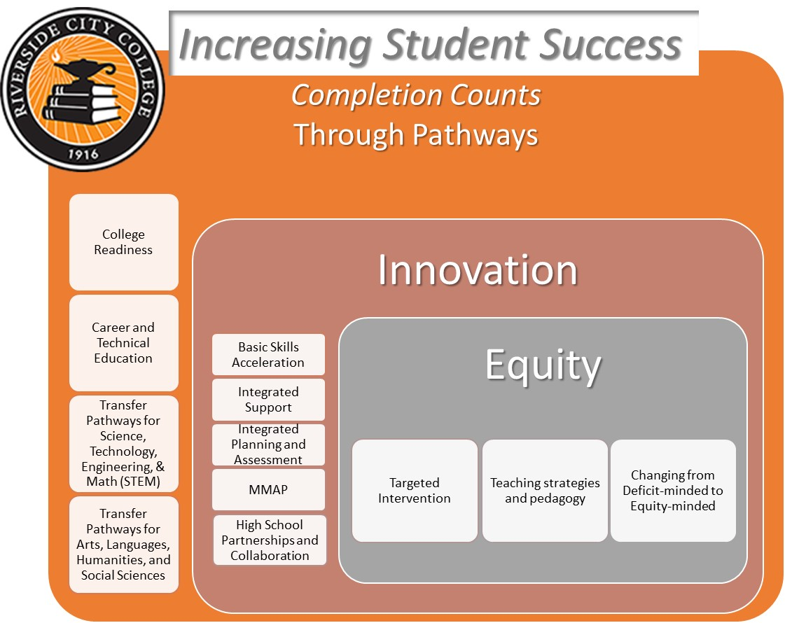

Slide 23
Pathways is about equity
By intentionally changing students’ trajectory, we contribute to
Providing value – taking the students in your classroom and giving them economic and social mobility
So, RCC needs to refocus on
Making the college ready for students versus the students ready for college
Rethinking how to help students succeed in Gateway Courses
Intentionally designing an experience that will help our students succeed
Partnering with 4-year institutions to ensure this design works for students beyond RCC

Slide 24
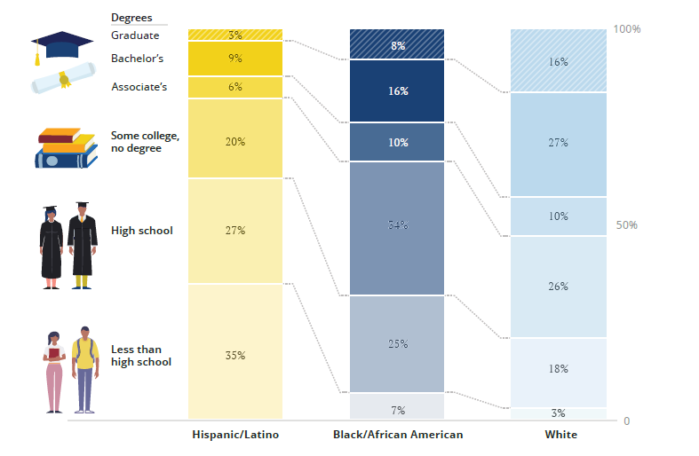
Educational Attainment by Race/Ethnicity in California
Source: Georgetown University Center on Education and the Workforce analysis of pooled ACS data (2011-15).

Slide 25
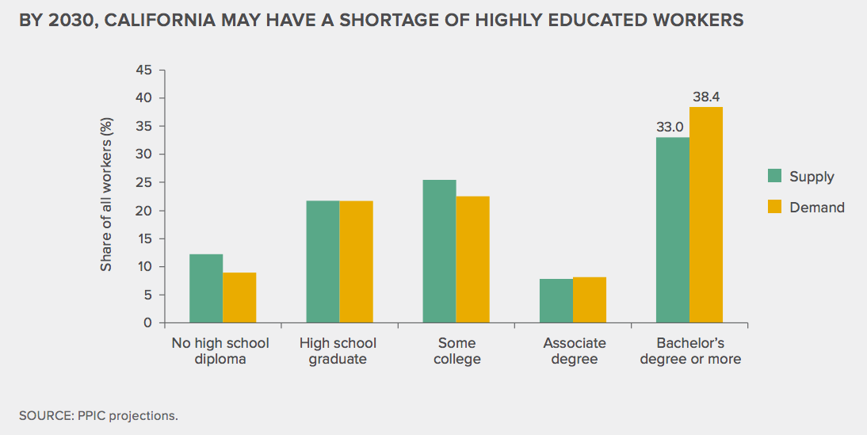
Projected Shortage of Colleges Workers in CA
Jackson, J., & Johnson, H. (2018). California’s Future: Higher Education. San Francisco, CA: Public Policy Institute of California
Notes:
Companies want to come here but won’t if we don’t have the workers

Slide 26
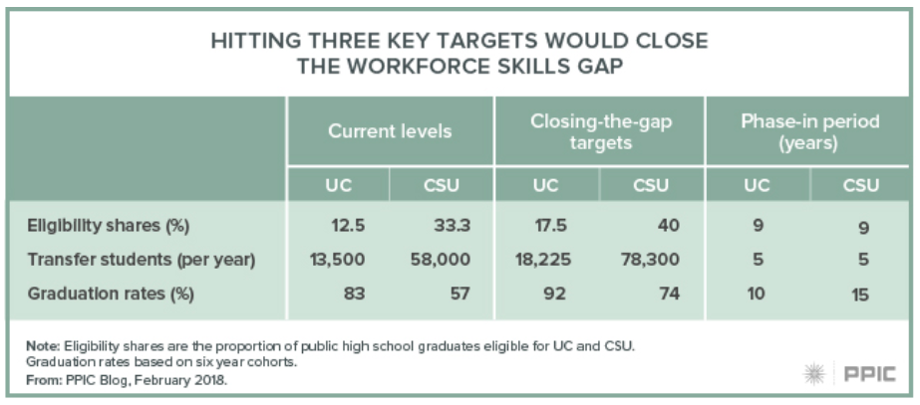
Role of Transfer in Meeting CA Bachelor’s
Demand

Slide 27
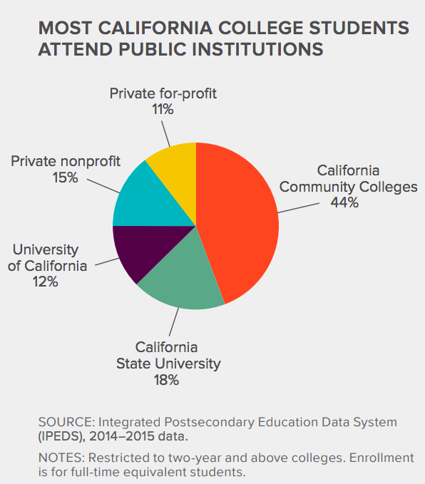
Where Californians Attend College
Jackson, J., & Johnson, H. (2018). California’s Future: Higher Education. San Francisco, CA: Public Policy Institute of California

Slide 28
California: Highest Outcomes in Six Years by Income Among FTEIC Degree-Seeking Community College Students (Excluding Dual Enrollment Students)
36% Completed Any Degree or Credential
30% Completed Any Degree or Credential
24% Completed Any Degree or Credential
Source: CCRC analysis of NSC data on the fall 2010 FTEIC, degree-seeking community college cohort.
Notes:
But…many students who start a community college don’t reach their educational goal…

Slide 29
What About at RCC? First-time freshmen Enrolling in 2010-2011 with fall 2017 status
55.4%
1.1%
30.6%
7.6%
5.3% (bottom 3)
Notes:
Wendy comment: And…this makes sense because our cohort completion rate is about 45%.

Slide 30
Riverside City College Transfer Volume Cohorts
Notes:
The economic impact of not completing are compelling—so how does the transfer picture look here at RCC?

Slide 31
RCC to CSUSB 5 Year Projection
5 years double
542 transfers
Notes:
And how about to our most frequent receiving institution?
Highest Transfer institutions:
# % of those who transferred
CSU-SAN BERNARDINO 683 14.3%
UNIVERSITY OF CALIFORNIA - RIVERSIDE 456 9.5%
CALIFORNIA BAPTIST UNIVERSITY 379 7.9%
CSU-FULLERTON 210 4.4%
UNIVERSITY OF PHOENIX 169 3.5%
CSU-POLYTECHNIC 167 3.5%
CSU-LONG BEACH 85 1.8%
LA SIERRA UNIVERSITY 82 1.7%
UNIVERSITY OF CALIFORNIA-LOS ANGELES 79 1.6%
ARIZONA STATE UNIVERSITY 71 1.5%
CSU-LOS ANGELES 69 1.4%
ITT TECHNICAL INSTITUTE 68 1.4%
CSU - POLYTECHNIC 63 1.3%
UNIVERSITY OF CALIFORNIA-IRVINE 62 1.3%
UNIVERSITY OF REDLANDS 56 1.2%
NATIONAL UNIVERSITY 53 1.1%

Slide 32



Transfer Applications, Admitted, Enrolled
Fall 2017 New Transfers | Applied | Admitted | Enrolled
CSUSB (all transfers) | 8982 | 4864 (54%) | 2335 (48%)
Norco, Moreno Valley, RCC | 1489 | 1104 (74%) | 519 (47%)
ADT (all transfers) | 389 | 384 (99%) | 339 (88%)
ADT Norco, Moreno Valley, RCC RCC ONLY | 89 55 | 89 (100%) 55 (100%) | 89 (100%) 55 (100%)
Notes:
Wendy can add a line on just RCC

Slide 33
Current Students
Undergraduate Transfer Students (all cohorts) | Enrolled Fall 2017
All Transfers | 6536
Norco, Moreno Valley, RCC | 1393
ADT (from all colleges) | 579
ADT Norco, Moreno Valley, RCC | 112

Slide 34

Target: Double the number of RCCD transfer students to CSUSB over the next 5 years
Notes:
UCR also aims to double number of transfers from RCCD over the next 5 years

Slide 35
So what are the barriers we have to address to make this work?

Slide 36
Barriers to Transfer Success
Transfer paths unclear
Inadequate advising and planning
Lack of early momentum
Students make progress, don’t transfer
Credit loss
We’ll focus on three of these today—1, 4, & 5
Notes:
Number these

Slide 37
Transfer Success Barriers
Transfer Paths Unclear

Slide 38



Website Exercise
Imagine you are a student about to register for classes at your community college.
You want to study biosciences and transfer to a local four-year university. Go to YOUR COLLEGE’S website, and find the information that you need to select your courses and transfer successfully. Try to figure out what courses you will need to in order to transfer and enter a biosciences program at the four-year institution.
Think about the following questions AS THE STUDENT:
Getting Off on the Right Start: What biosciences programs are available at nearby universities? What career options are available to you after you transfer and complete the degree? What do salaries look like for these career options? Is this information available to you on either website?
Planning for Program Requirements: What are the requirements for admission to the university’s biosciences programs? What classes will the student need to take at YOUR COLLEGE if you want to transfer into a bioscience program at the university? How easy or difficult was it to find this information? How many clicks did it take?
Locating In-Person Help: Who would you need to go at YOUR COLLEGE to get information on transfer in bioscience? Where would you go to on your campus to find that person? How easy or difficult was it to find this information on your website?
Notes:
Talk about the exercise we did here at RCC with the Pathways core group—THIS IS WHY PROGRAM MAPS

Slide 39
Enrollment Patterns among ~100K Bachelor’s Degree Completers from the Fall 2007 Entering CC Cohort
years at CC
+
years at 4yr
Few graduates follow 2+2 pattern

Slide 40
What About Part-Time Students?
So we know many of our students are part-time--let’s start asking why:
*
*
*
*
*
So there are many reasons so many of our students are part-time and some of them are because we have created institutional barriers and/ or haven’t fully articulated the benefits of being full-time to those who are able to be.
We need to beware of the single story.
https://www.ted.com/talks/chimamanda_adichie_the_danger_of_a_single_story
Notes:
Brainstorm together

Slide 41
Which of these barriers could RCC potentially help address?
Can’t afford books until financial aid comes in
No public transportation
Struggling in course and so withdraws
Family obligations
Unclear path to transfer
Course requires work in the library, attendance at a lab which are not open evenings, weekends
Must work to support self and family
Schedule conflicts
Needed course is unavailable
Don’t want to attend full-time
Also taking classes at another college

Slide 42
Transfer Success Barriers
Students Make Progress, Don’t Transfer

Slide 43
Why Aren’t More Students Transferring?
The answers will be complex, but as an institution, we have to study and address these and work head on to address those that are of our own making.
Notes:
Need help with info on this one

Slide 44
Median credits earned by associate degree completers 20 CCC programs with the most completers in 2015-16
Data. Analysis of CCC student records courtesy of Education Results Partnership

Slide 45
Transfer Success Barriers
Credit Loss

Slide 46
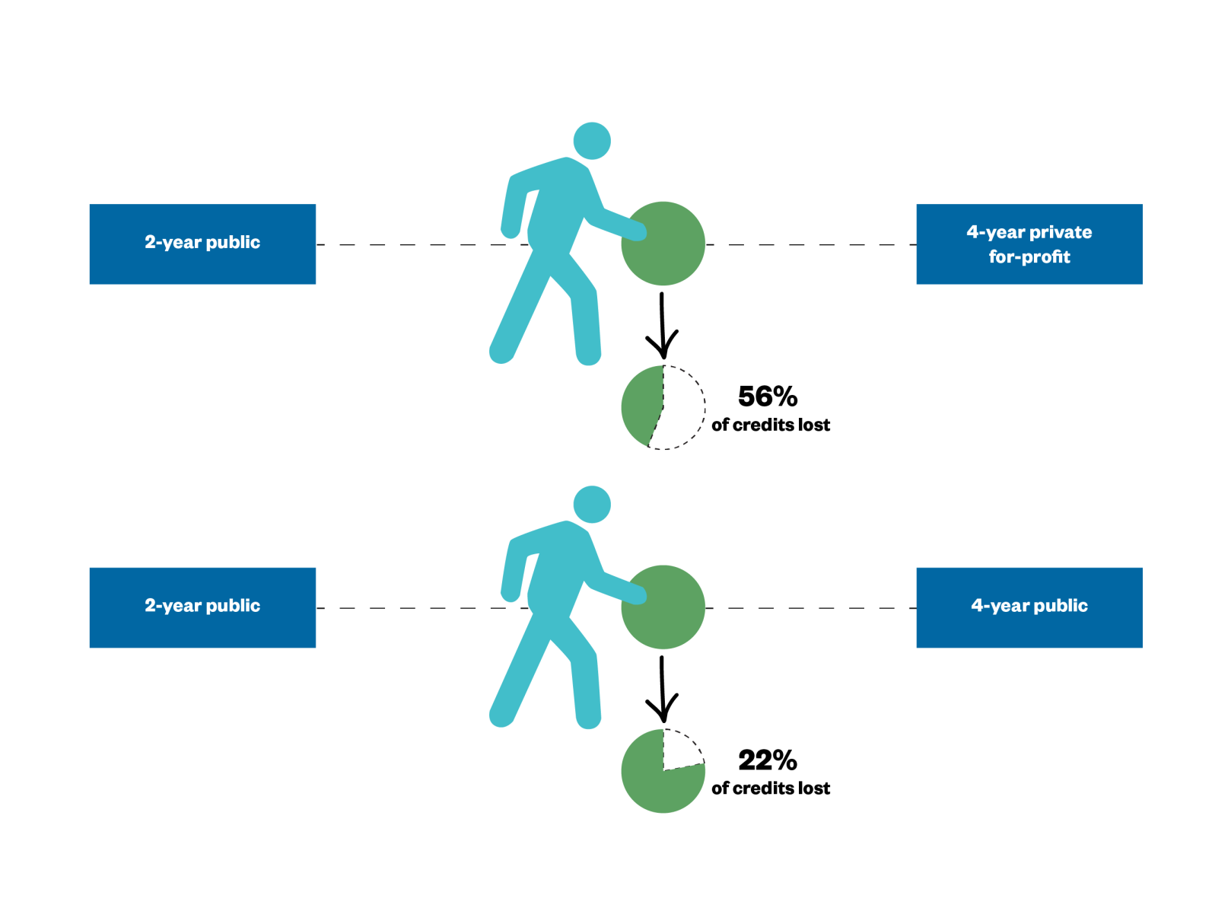
Estimated Percentage of Credits Lost in Transfer, on Average, by Transfer Path, Academic Years 2003-04 to 2008-09
Source: GAO analysis of Department of Education transfer and tuition data | GAO-17-574

Slide 47
Just 58% of students
successfully transferred
90% of their credits.
And 15% can’t transfer any credits at all.
Students who can transfer 90% of their credits were 2.5x more likely to get their bachelor's degree, compared to those who transfer half or less.
Source: BPS data, Monaghan & Attewell, 2015.

Slide 48
There is a difference between transferability and applicability to a degree/ program of study after transfer
What institutional structures, practices contribute to the problem?
What is in our control to address and change?
What work can we do with partners to ensure our students are successfully able to transfer more degree applicable credits?

Slide 49

Discussion Questions
What is your understanding of how Guided Pathways integrates with RCC’s Strategic Plan and Student Success, Access, and Equity goals?
How well aligned are our programs (including transfer paths) with career opportunities in our region?
Are there steps we can take as an institution to help students who could be full-time do so?
Why don’t more CA cc students transfer? Why don’t more transfer with a community college degree or certificate? Do most of our students know about ATDs and TAGs? Are we advising students to pursue them? If not, why not? How can we improve the impact of ADTs and TAGs?
What might we unintentionally be doing as an institution that creates barriers to students completing?
How do you see Guided Pathways helping improve our students’ ability to complete their goals here at RCC?

